Slide 1



Presentation XI
Literature Review
Thu Ta Zaw
2415121095

Slide 2

Prediction of tissue optical properties using the Monte Carlo modeling of photon transport in turbid media and integrating sphere
Monte Carlo simulation is used for simulating light transport in biological tissue.
Integrating spheres make experimental measurements of the reflectance and transmittance of a sample.
In this research, the Integrating Sphere Monte Carlo (ISMC), which is the extension of Monte Carlo Photon transport methods to simulate the propagation of photons in Integrating Sphere is presented.
Validated with previous work on Monte Carlo photon transport, and experimental measurements of a synthetic tissue phantom validate this method.
Presented tow approach lookup table method and multivariable minimization method to back-calculate the optical properties of samples.

Slide 3
Prediction of tissue optical properties using the Monte Carlo modeling of photon transport in turbid media and integrating sphere
Solved problem of standard Monte Carlo (MC) models ignore integrating sphere geometry.
Integrating spheres cause photon re-incidence and sphere-to-sphere crosstalk, which can lead to inaccurate inverse solution with error over >20%.
ISMC models photon interactions with integrating spheres and accounts for photon re-incidence and dual-sphere crosstalk.
It is computationally efficient and avoids full ray-tracing inside spheres and only requires only one simulation per illumination.
Supports both single and dual sphere configurations.
Experimental and simulation uncertainties are propagated through both methods.

Slide 4
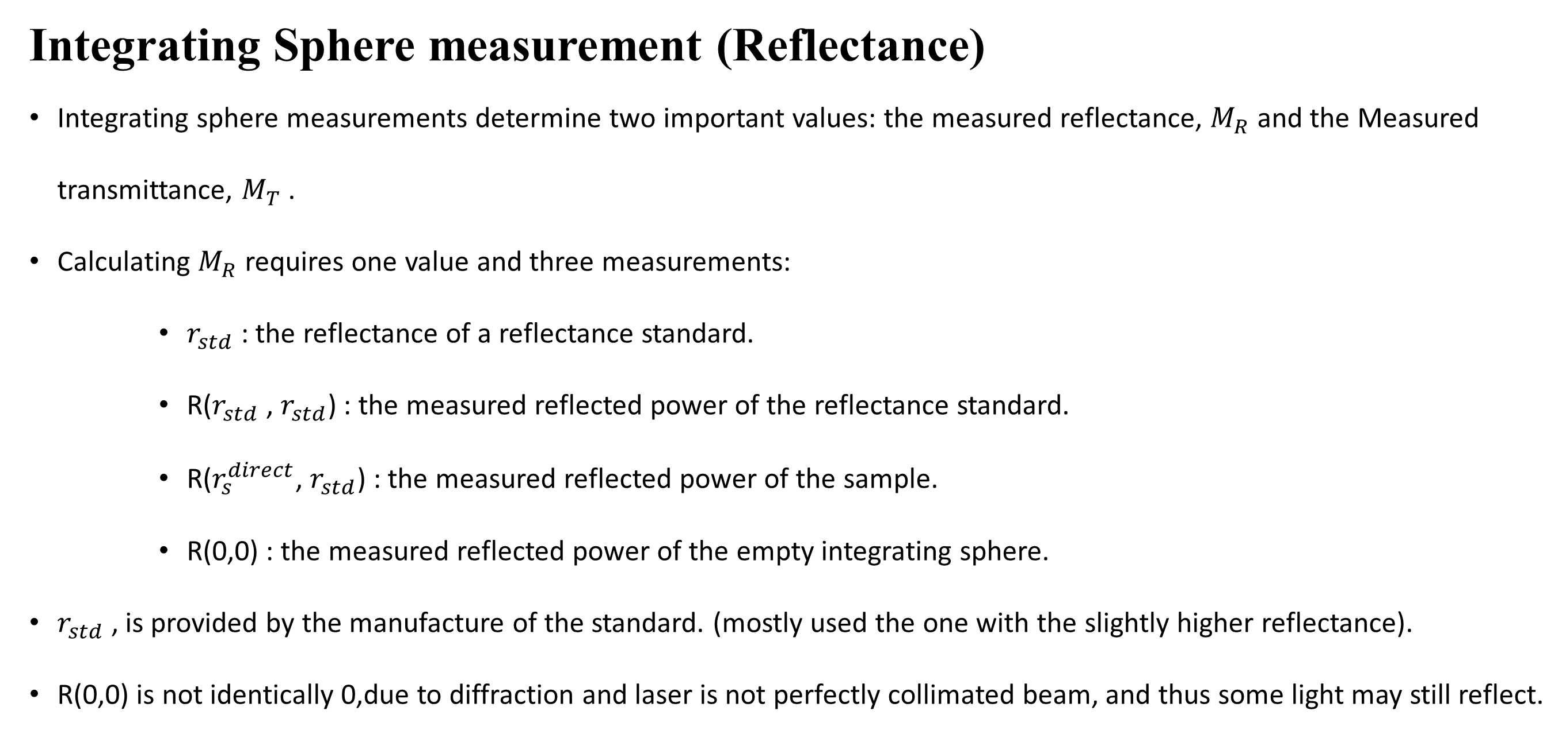
Integrating Sphere measurement (Reflectance)
Integrating sphere measurements determine two important values: the measured reflectance, $M_{R}$ and the Measured transmittance, $M_{T}$ .
Calculating $M_{R}$ requires one value and three measurements:
$r_{std}$ : the reflectance of a reflectance standard.
R($r_{std}$ , $r_{std}$) : the measured reflected power of the reflectance standard.
R($r_{s}^{direct}$, $r_{std}$) : the measured reflected power of the sample.
R(0,0) : the measured reflected power of the empty integrating sphere.
$r_{std}$ , is provided by the manufacture of the standard. (mostly used the one with the slightly higher reflectance).
R(0,0) is not identically 0,due to diffraction and laser is not perfectly collimated beam, and thus some light may still reflect.

Slide 5
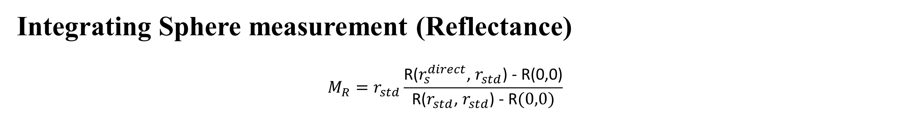
Integrating Sphere measurement (Reflectance)
$${M_{R}=r}_{std}\frac{\text{R}\text{(}r_{s}^{direct}\text{, }r_{std}\text{)}\text{ − }\text{R}\text{(0,0)}}{\text{R}\text{(}r_{std}\text{, }r_{std}\text{)}\text{ − }\text{R}(0,0)}$$
Fig. Configurations necessary to make the measurements required for the calculation of $M_{R}$
Notes:
$$r_{std}$$

Slide 6

Integrating Sphere measurement (Transmittance)
Calculating $M_{T}$ requires the following measurements:
$T_{dark}$ : the measured transmitted power with the laser blocked or turned off.
T($r_{s}^{direct}$, $r_{s}$) : the measured transmitted power of the sample.
T(0,0) : the measured transmitted power of the empty integrating sphere.
$T_{dark}$ is not necessarily 0 since the detector in the sphere is not perfect and will likely measure some background even when in darkness.

Slide 7
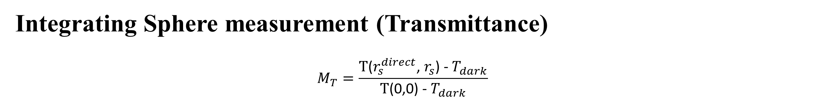
Integrating Sphere measurement (Transmittance)
$$M_{T}=\frac{\text{T}\text{(}r_{s}^{direct}\text{, }r_{s}\text{)}\text{ −}{ T}_{dark}}{\text{T}\text{(0}\text{,}\text{0}\text{)}\text{ −} T_{dark}}$$
Fig. Configurations necessary to make the measurements required for the calculation of $M_{T}$
Notes:
$$r_{std}$$

Slide 8

Integrating Sphere measurement (Regular or unscattered transmittance)
Calculating $M_{U}$ requires the following measurements:
$U_{s}$ : the measured regular transmitted power of the sample.
$U_{0}$ : the measured transmitted power with the aperture closed.
$U_{100}$ : the measured regular transmitted power of the unabated laser.
$U_{0}$ is not always 0 because of external lighting and noise from the detector itself.
In practice, Mu is difficult to determine accurately due to the massive difference in $U_{100}$ and $U_{0}.$

Slide 9
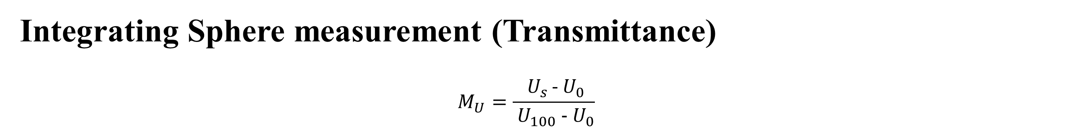
Integrating Sphere measurement (Transmittance)
$$M_{U}=\frac{{ U}_{s }\text{−}{ U}_{0}}{{ U}_{100}\text{ −}{ U}_{0}}$$
Fig. Configurations necessary to make the measurements required for the calculation of $M_{U}$
Notes:
$$r_{std}$$

Slide 10

Integrating Sphere measurement (Regular or unscattered transmittance)
The additional required values are:
The inner wall reflectance
Diameter of the sphere
Diameter of each port.
Maximum permissible polar angle measured from the central axis of the incident laser which will be use as a threshold for regular transmittance.
The maximum permissible polar angle is $θ_{U}$and it is calculated from the aperture diameter, A, and the distance of the aperture from the sample, l.
$$θ_{U}=\tan^{−1}\frac{A}{2l}$$

Slide 11
Methods
Extends the standard Monte Carlo photon transport to include integrating sphere.
Tracks photons after exiting the sample:
Photons escape through ports
Detection of photons at the detector
Absorption of photons by the sphere wall
Photons re-incidence on sample
Uses analytical probability for photon re-incidence (no ray tracing)
Integrating sphere is modeled using the wall reflectance, ports fractional areas and detector fractional areas.
Accounts for sphere-to-sphere crosstalk which enables using for both single and double integrating sphere.
Uses Monte Carlo statistics to estimate simulation uncertainty.

Slide 12
Assumptions and modifications
Surface roughness effects is ignored as in common MC simulations sample is placed between the glass slides.
Baffle is assumed to be large enough to block the photons to directly enters the detector paths and small enough not to block the photons to escapes though the source port.
Baffle is treated as sphere wall and sphere walls is assumed ideal Lambertian.
Photons are assumed to exit and re-enter sample at port center, which could cause over estimation of R and T.
Sample is assumed infinite laterally and side losses are ignored which could overestimate the absorption coefficient.
For the unbaffled sphere, the photons that directly enter into the detector counted immediately as R or T.
No charge to re-incidence equations.

Slide 13
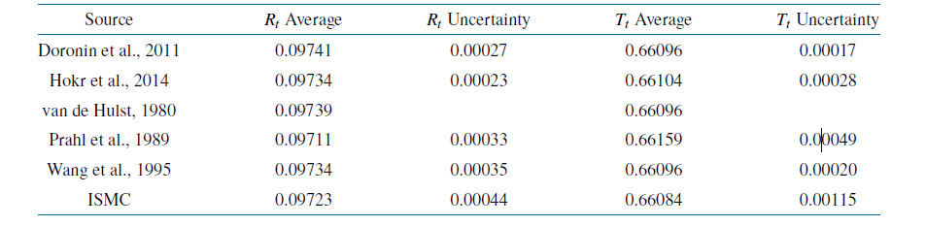
Verification
Verification with previous work on Monte Carlo simulation without sphere
Has Excellent agreement when comparing with the established MC codes for Total reflectance, total transmittance for the index-matched boundary condition.
Table 1. Verification for a sample with a refractive-index-matched boundary

Slide 14
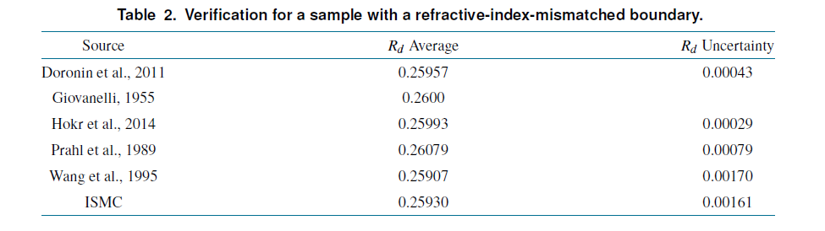
Verification
Verification with previous work on Monte Carlo simulation without sphere
Achieved excellent agreement for the diffuse reflectance for index-mismatched boundary condition.
Table 2. Verification for a sample with a refractive-index-mismatched boundary

Slide 15
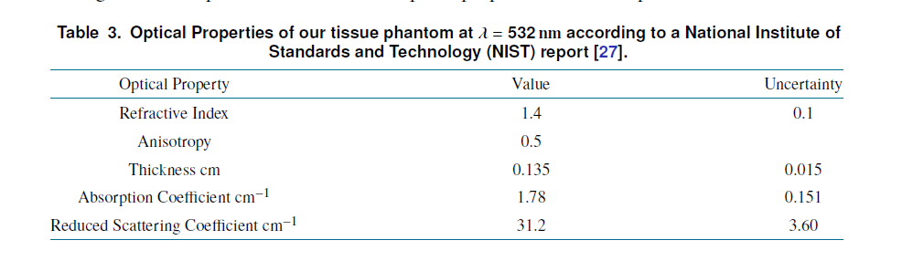
Verification
Verified with the integrating sphere experiment performed on a synthetic tissue phantom
ISMC simulation results closely match experimental diffuse reflectance and diffuse transmittance.
Table 3. Optical properties of the tissue phantom at wavelength 532 nm according to the National Institute of Standards and Technology (NIST) report

Slide 16

Application to measuring optical properties
Estimate the optical properties, absorption coefficient $μ_{a}$ and reduced scattering $μ_{s}^{′}$ by using the diffuse reflectance $M_{R}$ , diffuse transmittance $M_{T}$ and optional regular transmittance $M_{U}$ .
Lookup Table method
Simulate the wide range of $μ_{a}$ and $μ_{s}^{′}$ values and stores the corresponding R and T results.
Invert the table to find the optical properties.
It is easy to understand and suitable for multiple similar samples.
Fig. Lookup table for (a) absorption coefficient and (b) for reduced scattering coefficient
n = 1.4, g = 0.9 and t = 1 cm with a zero-sphere setup.

Slide 17
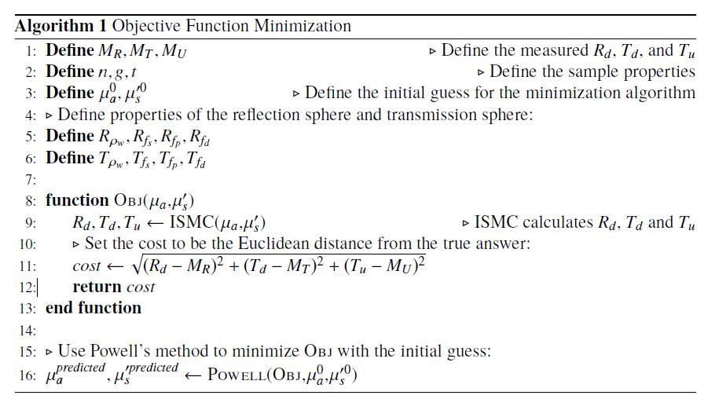
Application to measuring optical properties
Multivariable minimization method
Define the objective function for the difference between measured values and simulation result
Notes:
Powell’s method don’t require the input function derivative.

Slide 18
Propagation of uncertainties
Lookup table method
Required both forward propagation and backward propagation.
Combined experimental and simulation uncertainties for the final uncertainty.
Minimization method
Only forward propagation is required.
Randomly samples the experimental uncertainties (), simulation and sphere parameter uncertainties.
Run multiple minimizations.
Final uncertainty is equal to the standard error of the mean.
Both methods yield realistic and comparable uncertainty estimates.
Notes:
Powell’s method don’t require the input function derivative.

Slide 19
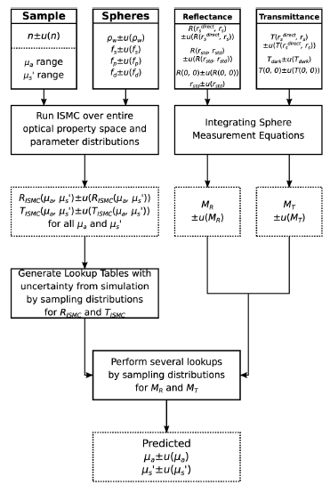
Propagation of uncertainties
Lookup table method
Fig. A flowchart showing the propagation of uncertainties through the lookup table method
Notes:
Powell’s method don’t require the input function derivative.

Slide 20

A Monte Carlo estimation of tissue optical properties for use in laser dosimetry
It is important to consider the light dosimetry in certain clinical situation, such as photodynamic therapy.
The propagation of light tissues is influenced by microscopic properties (absorption coefficient $μ_{a}$, scattering coefficients $μ_{s}^{′}$, refractive index n, and anisotropy factor g), which can be calculated from direct or indirect methods if tissue macroscopic properties, such as reflectance, transmittance or collimated transmittance, are measured.
In this research, an inverse method using the graphical approach, in which Monte Carlo simulations were performed for a wide range of skin type, to get the optical coefficients.
The method can be used either direct or indirect techniques by making assumptions.
It can be also applied for any tissue type, detector geometry and experimental apparatus, with good accuracy.
The results of the method are in good agreement with theoretical and experimental results of other investigators.

Slide 21

Methods
Direct method required to make the measurement in tissue sample thin enough that single-photon scattering occurs (tissue thickness need to be less than the mean free path length, which is a few micrometer).
Indirect method measures the reflectance and transmittance in bulk tissue; and used there value along with the sample thickness and light propagation model to determine the microscopic coefficients.
Performed Monte Carlo simulation in FORTRAN, which simulate the irradiation of a three-dimensional parallel slab of tissue of a given thickness with a collimated light beam.
Variable-step-size Monte Carlo method was used, in which randomly generally photons are forced either to be scattered or absorbed according to the formulae $S_{abs}=−\frac{(\ln{R})}{μ_{a}}$ and $S_{scatt}=−\frac{\left(\ln{R}\right)}{μ_{s}}$, where r is a random number [0,1]. If a photon is scattered, a new photon direction is chosen according to the Henyey-Greenstein phase function. Otherwise, a new photon is generated.
If the sample consisted of several layers, the photon either crossed the boundary according to the Snell’s law, or if it was internally reflected according to the Fresnel’s law.

Slide 22

Assumptions and parameters
100,000 photons are generated for each iteration.
The tissue slab is assumed to be exposed to the light beam without being compressed with transparent plates.
Input data are:
Beam shape (collimated, diverging, focused beam or point source) -> [used collimated beam]
Beam diameter -> [1 cm]
The location of entrance point -> [center of the tissue sample]
The incident angle -> [normal to the slab]
The beam cross-sectional area at the exit (for collimated transmittance only)
The tissue thickness -> [1 cm]
Optical properties of tissue -> [g = 0.8, n = 1.36 and 1.45, $μ_{a}$= {0.0156:4}${cm}^{−1}$ , $μ_{s}$= {0.5:20}${cm}^{−1}$]
The surface of the tissue is wide enough, compared to the beam’s cross-section -> [consider infinite]
Found that there is a difference of 15% in specular reflectance and the difference for diffuse transmittance and total reflectance were less than 4% for two different refractive index.

Slide 23
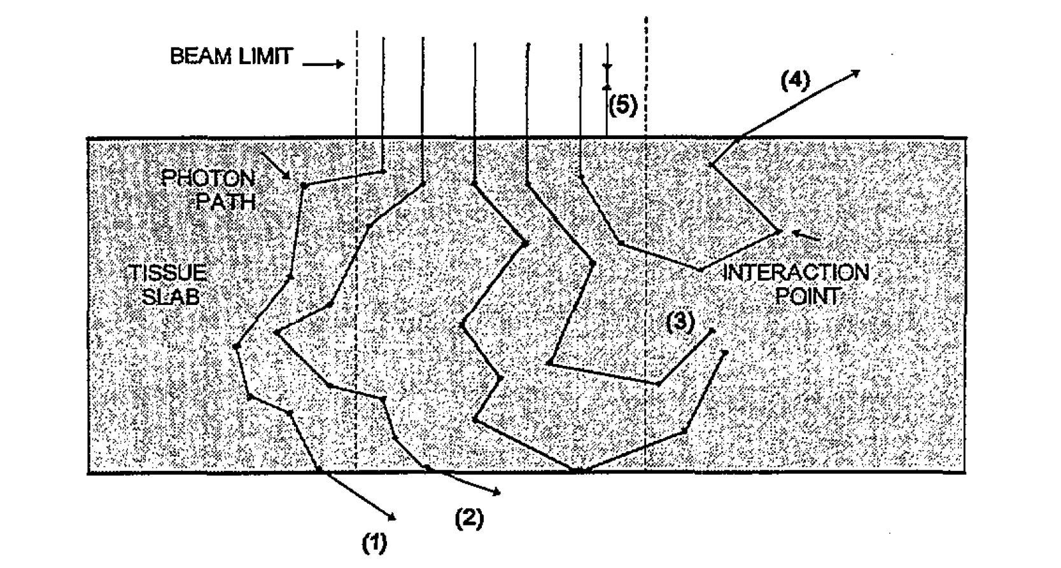
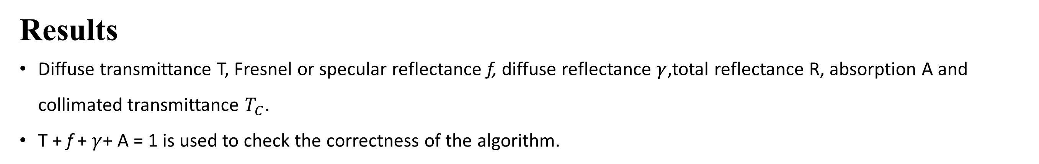
Results
Diffuse transmittance T, Fresnel or specular reflectance f, diffuse reflectance $γ$,total reflectance R, absorption A and collimated transmittance $T_{C}$.
T + f + $γ$+ A = 1 is used to check the correctness of the algorithm.
Fig, Types of photon path passing through a tissue slab. The paths considered in the Mote Carlo code are the following: diffuse transmittance T(1+2); collimated transmittance $T_{C}$ (2); fraction absorbed A (3); diffuse reflectance $γ$(4);specular (Fresnel) reflectance f (5); total reflectance R (4+5)

Slide 24
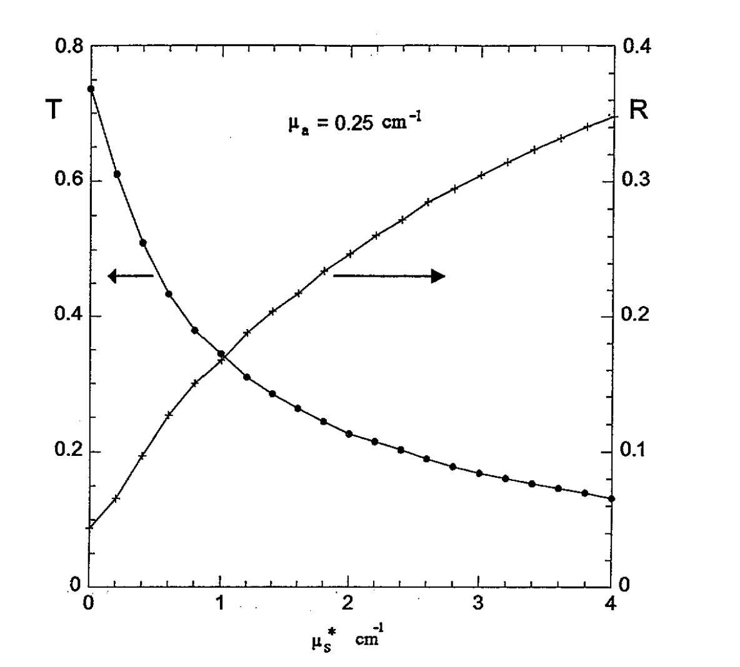
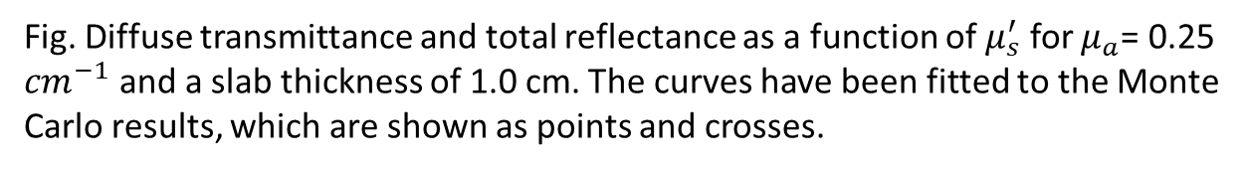
Results
Used 100,000 histories for each run.
The overall reproducibility of all calculated quantities was over 99%.
The following figure shows the plots fitted to the data.
Fig. Diffuse transmittance and total reflectance as a function of $μ_{s}^{′}$ for $μ_{a}$= 0.25 ${cm}^{−1}$ and a slab thickness of 1.0 cm. The curves have been fitted to the Monte Carlo results, which are shown as points and crosses.

Slide 25
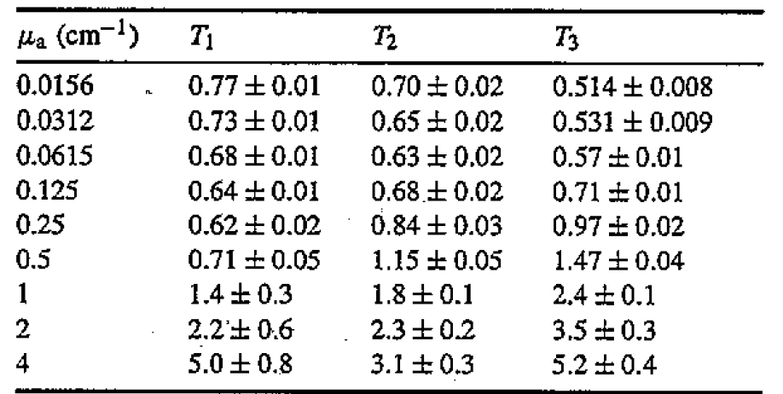
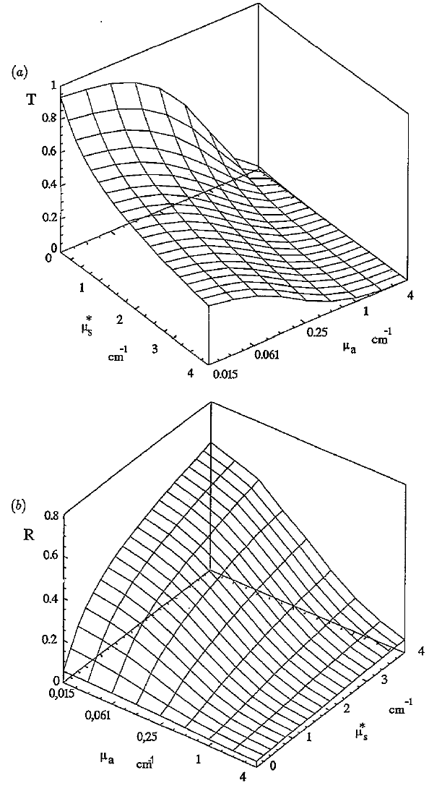
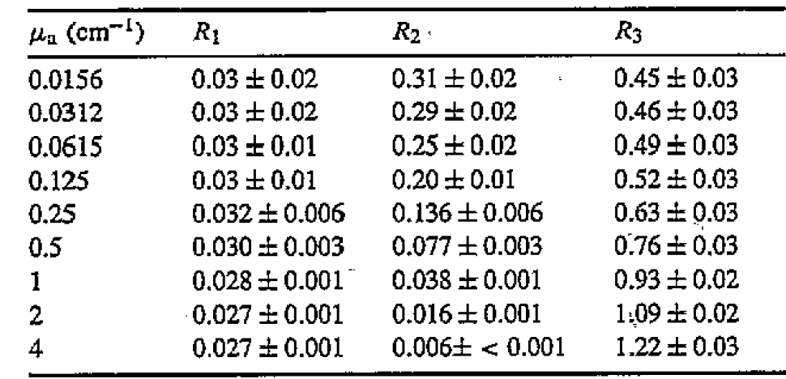
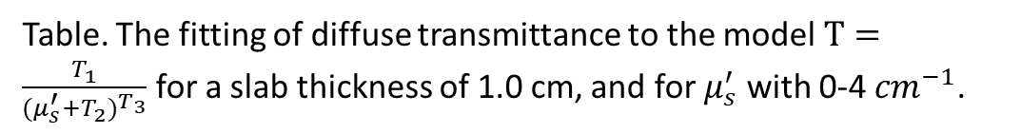
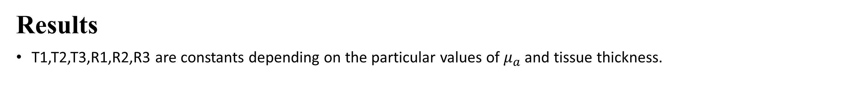
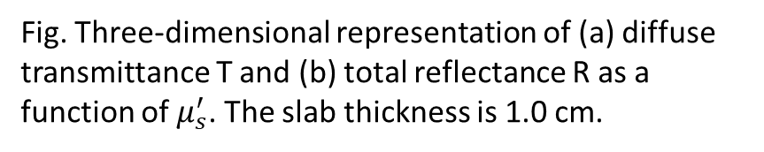
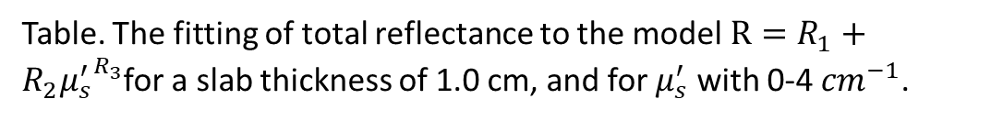
Results
T1,T2,T3,R1,R2,R3 are constants depending on the particular values of $μ_{a}$ and tissue thickness.
Table. The fitting of diffuse transmittance to the model $T=\frac{T_{1}}{{(μ_{s}^{′}+T_{2})}^{T_{3}}}$ for a slab thickness of 1.0 cm, and for $μ_{s}^{′}$ with 0-4 ${cm}^{−1}$.
Fig. Three-dimensional representation of (a) diffuse transmittance T and (b) total reflectance R as a function of $μ_{s}^{′}$. The slab thickness is 1.0 cm.
Table. The fitting of total reflectance to the model$R=R_{1}+{{R_{2}μ}_{s}^{′}}^{R_{3}}$for a slab thickness of 1.0 cm, and for $μ_{s}^{′}$ with 0-4 ${cm}^{−1}$.

Slide 26
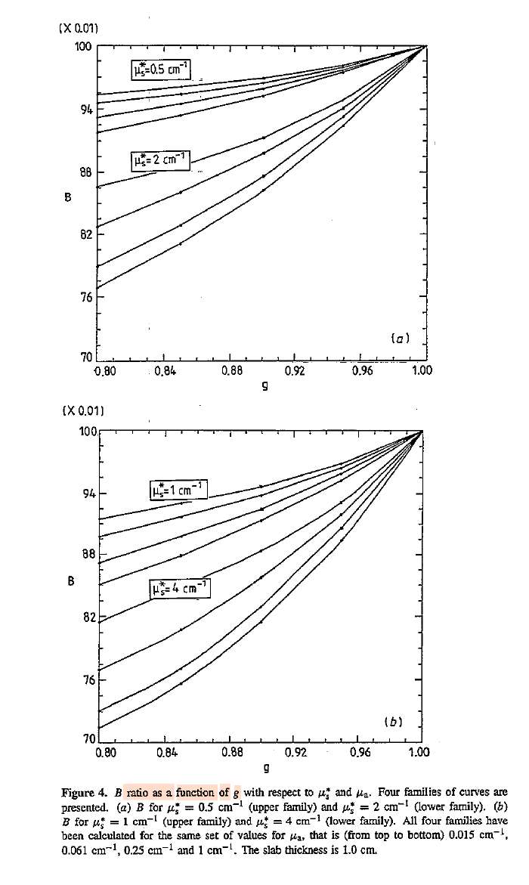
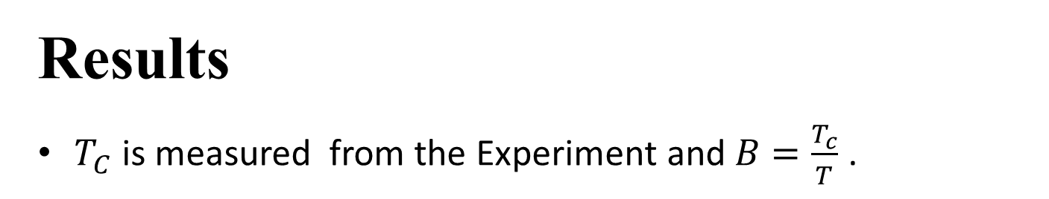
Results
$T_{C}$ is measured from the Experiment and $B=\frac{T_{c}}{T}$ .
Fig. B ratio as a function of g with respect to $μ_{a}$ and $μ_{s}^{′}$. Four similarity curves are presented (a) B for $μ_{s}^{′}$= 0.5 ${cm}^{−1}$(upper family) and $μ_{s}^{′}$ = 2 ${cm}^{−1}$(lower family). (b) B for $μ_{s}^{′}$= 1 ${cm}^{−1}$(upper family) and $μ_{s}^{′}$ = 4 ${cm}^{−1}$. All four families have been calculated for the same set of values for $μ_{a}$. That is (form top to bottom)0.015${cm}^{−1}$,0.061${cm}^{−1}$,0.25${cm}^{−1}$and 1 ${cm}^{−1}$. The slab thickness is 1.0 cm.

Slide 27
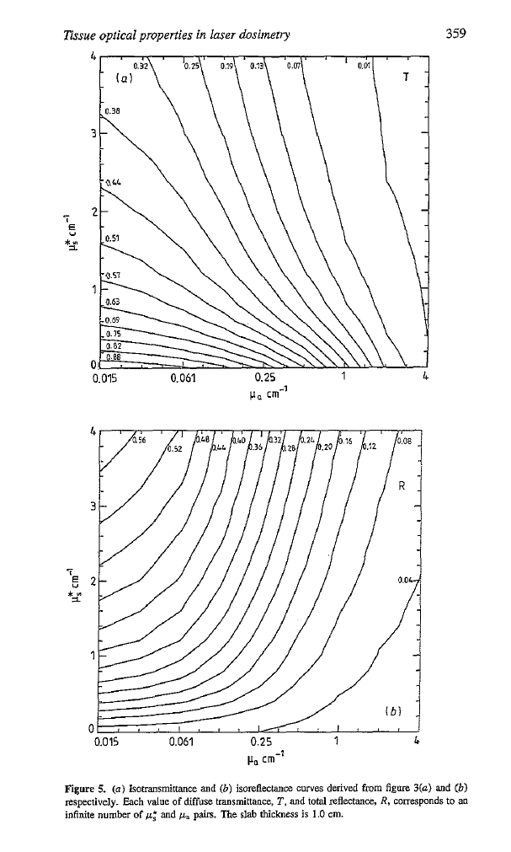
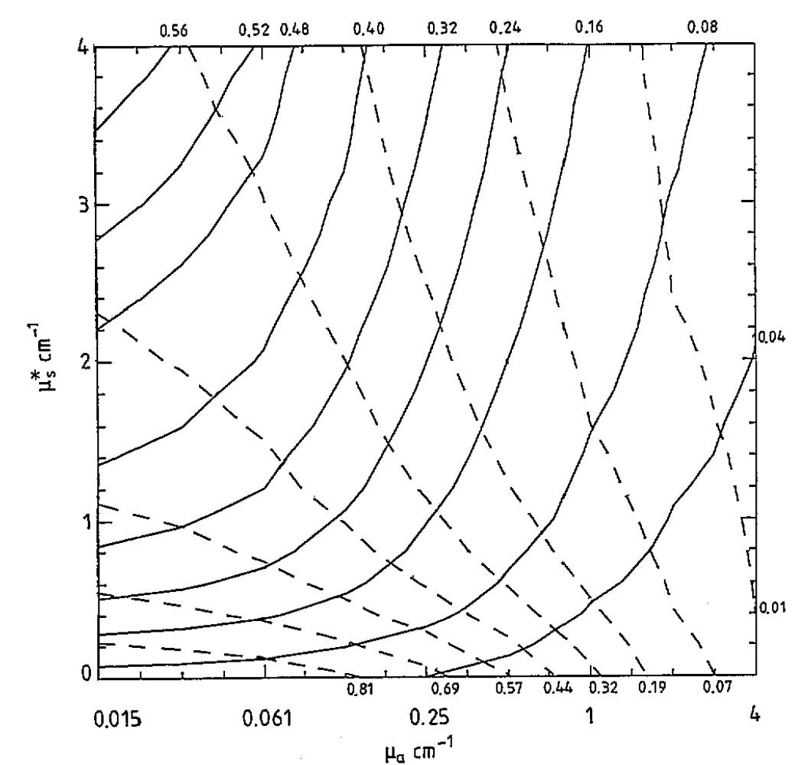
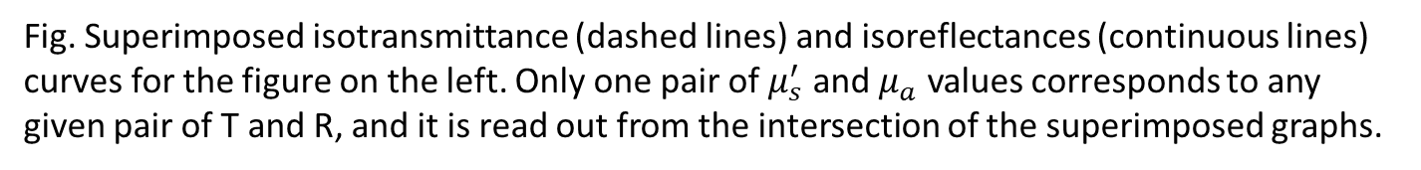
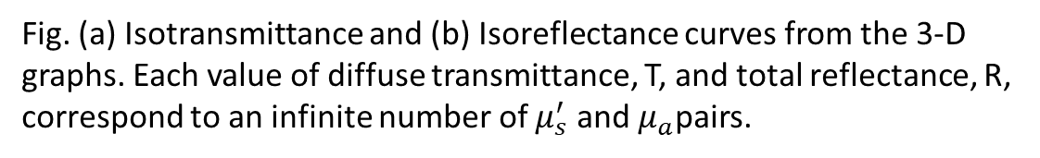
Results
Isotransmittance and isoreflectance curves is presented, we can get a unique pairs of $μ_{s}^{′}$ and $μ_{a}$ if R and T are known.
Fig. (a) Isotransmittance and (b) Isoreflectance curves from the 3-D graphs. Each value of diffuse transmittance, T, and total reflectance, R, correspond to an infinite number of $μ_{s}^{′}$ and $μ_{a}$pairs.
Fig. Superimposed isotransmittance (dashed lines) and isoreflectances (continuous lines) curves for the figure on the left. Only one pair of $μ_{s}^{′}$ and $μ_{a}$ values corresponds to any given pair of T and R, and it is read out from the intersection of the superimposed graphs.

Slide 28
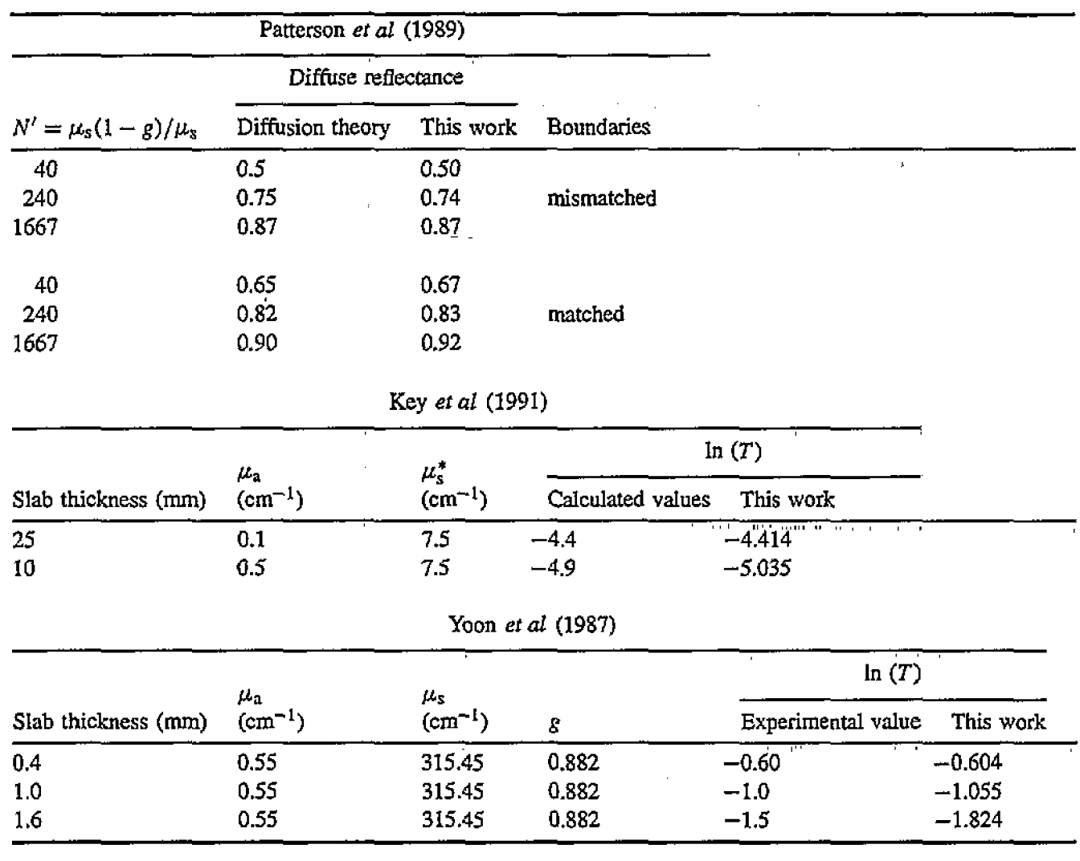
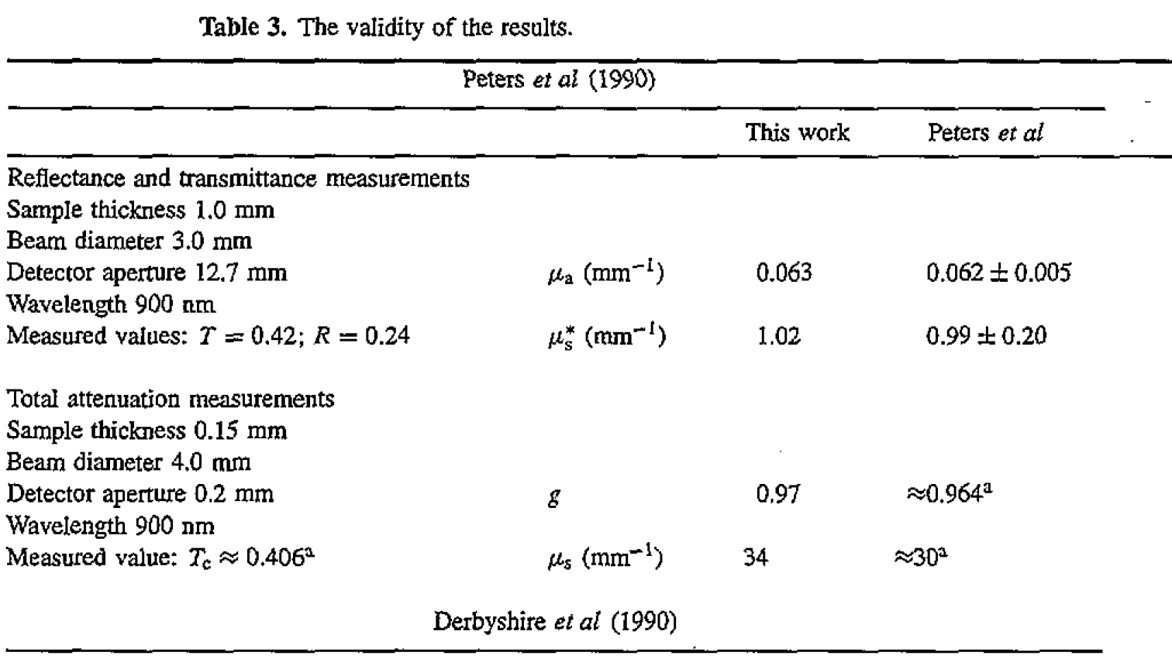
Validation
Compared with the published literature with the same experimental condition to validate the results and the accuracy of the code.
Table. The validity of the results
Table. The accuracy of the code

Slide 29
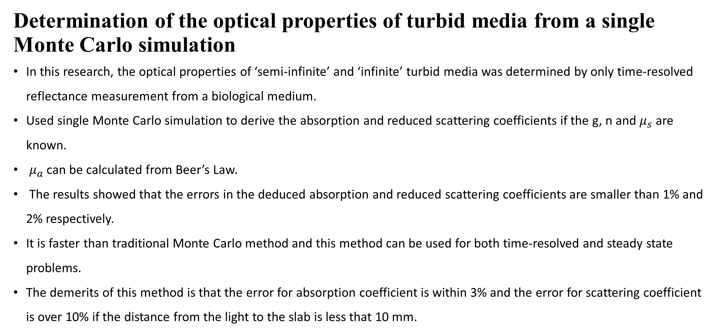
Determination of the optical properties of turbid media from a single Monte Carlo simulation
In this research, the optical properties of ‘semi-infinite’ and ‘infinite’ turbid media was determined by only time-resolved reflectance measurement from a biological medium.
Used single Monte Carlo simulation to derive the absorption and reduced scattering coefficients if the g, n and $μ_{s}$ are known.
$μ_{a}$ can be calculated from Beer’s Law.
The results showed that the errors in the deduced absorption and reduced scattering coefficients are smaller than 1% and 2% respectively.
It is faster than traditional Monte Carlo method and this method can be used for both time-resolved and steady state problems.
The demerits of this method is that the error for absorption coefficient is within 3% and the error for scattering coefficient is over 10% if the distance from the light to the slab is less that 10 mm.

Slide 30
Methods
A point source with an infinitely small pulse was used, and the length of the photon path was computed to obtain the travel time through the turbid medium.
Convolution was applied to calculate the reflectance for arbitrary sources as the Henyey-Greenstein phase function was used.
Simulated the slab with 30 m thickness which considered semi-infinite.
Refractive index, n is about1.4 for all soft tissue.
Different anisotropy factors do not significantly influence the time-resolved reflectance if g is closed to 1. g = 0.8 is used.
Similarity relationship was used to reduced more unknown optical parameters.
It is important that the desired quantities for other optical coefficients and refractive index does not change when the anisotropy factor is the same.

Slide 31
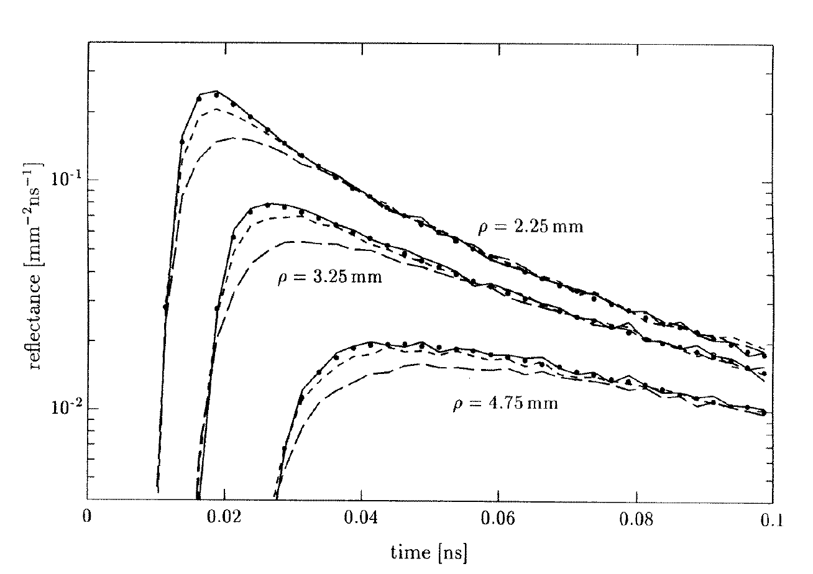

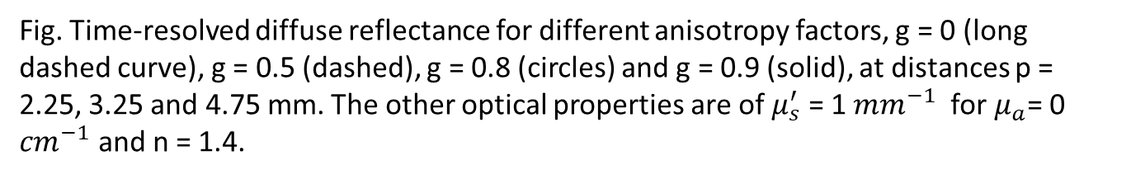
Similarity Relation
This relation states that different combinations of anisotropy factor and scattering coefficient can produce similar optical behavior, such as diffuse reflectance.
The conservation of reduced scattering coefficient is used.
$$μ_{s}^{′}=μ_{s}(1−g)$$
The results showed that simple similarity relation is valid when g is over 0.8.
Simulations are performed at g = 0.8 as it is biological tissue g is greater than 0.8 and computational efficiency is better at lower g value.
Fig. Time-resolved diffuse reflectance for different anisotropy factors, g = 0 (long dashed curve), g = 0.5 (dashed), g = 0.8 (circles) and g = 0.9 (solid), at distances p = 2.25, 3.25 and 4.75 mm. The other optical properties are of $μ_{s}^{′}$ = 1 ${mm}^{−1}$ for $μ_{a}$= 0 ${cm}^{−1}$ and n = 1.4.

Slide 32
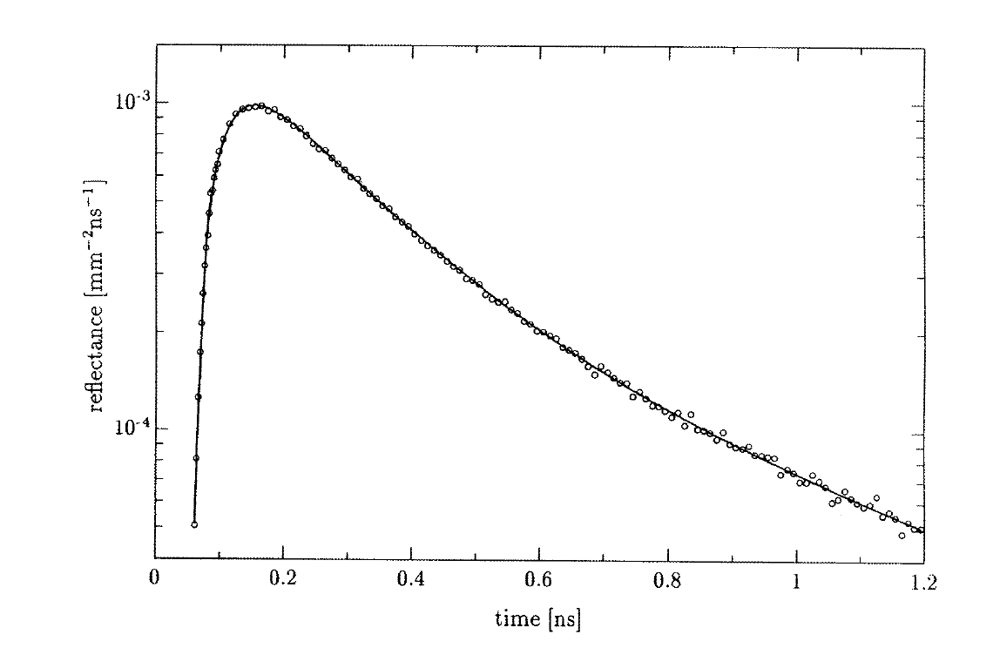

Results
The time-resolved reflectance is measured at a certain distance, p, at different time-values R($t_{i}$).
Interpolation of reflectance data produced by Monte Carlo simulation is done to evaluate the reflectance at these times for each iteration of non-linear regression.
For interpolation, used the arbitrary function to approximate the R(t) curves of the Monte Carlo simulation which provided good fit to the logarithm of the time-resolved reflectance of all p values.
$$\ln\left(R\left(t\right)\right)=c_{0}+c_{1}ln⁡t+c_{2}{(lnt)}^{2}+…+c_{10}{(lnt)}^{10}$$
Created all R(t) curves for the intermediate distances by fitting ln(R()
Fig, Regression (solid curve) to a Monte Carlo simulation (circles). The parameters of the simulation are $μ_{s}^{′}$ = 1 ${mm}^{−1}$ , $μ_{a}$= 0 ${mm}^{−1}$, n = 1.4, g = 0.8 and p = 9.75 mm.

Slide 33
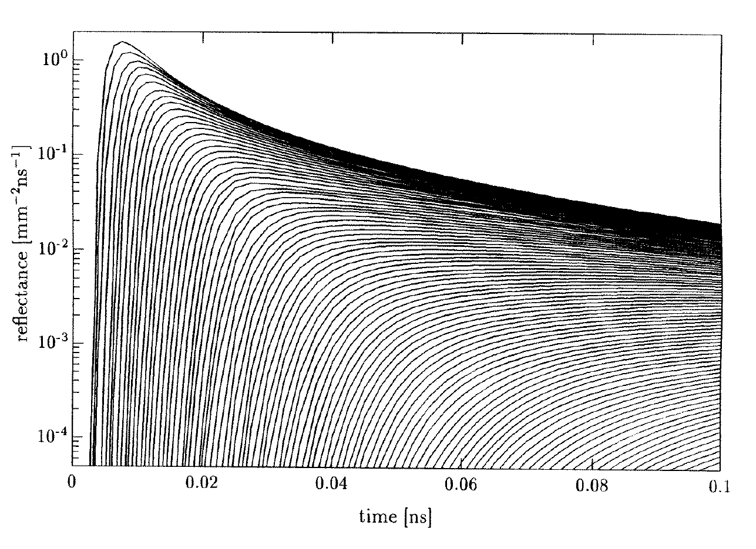
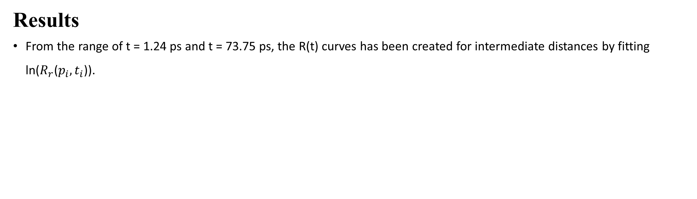
Results
From the range of t = 1.24 ps and t = 73.75 ps, the R(t) curves has been created for intermediate distances by fitting ln($R_{r}$($p_{i},t_{i}$)).
Fig. A sample of the 157 fitted time-resolved reflectance curves. The parameters of the Monte Carlo simulations are $μ_{s}^{′}$ = 1.0 ${mm}^{−1}$ , $μ_{a}$= 0 ${mm}^{−1}$, g = 0.8, n = 1.4 and 1<p<1.25 mm; the top curve is for p = 1 mm, the bottom curve is for p = 12.5 mm, and the other curves have been calculated for intervals of 0.125 mm.

Slide 34
The End
THANK YOU FOR LISTENING
Thu Ta Zaw
2415121095

